Slide 1

Introduction to I1DISP
River Examples
Lake Examples

Slide 2
River Examples
Examples 3.1 – 3.3

Slide 3
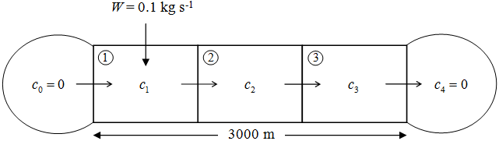
Example 3.1 - Summary
A = 20 m² L = 3000 m u = 0.1 m/s
E = 0.0 m²/s Δx = 1000 m W = 0.1 kg/s
k = 10⁻⁴ s⁻¹

Slide 4
Example 3.1 – Analytical Solution

Slide 5
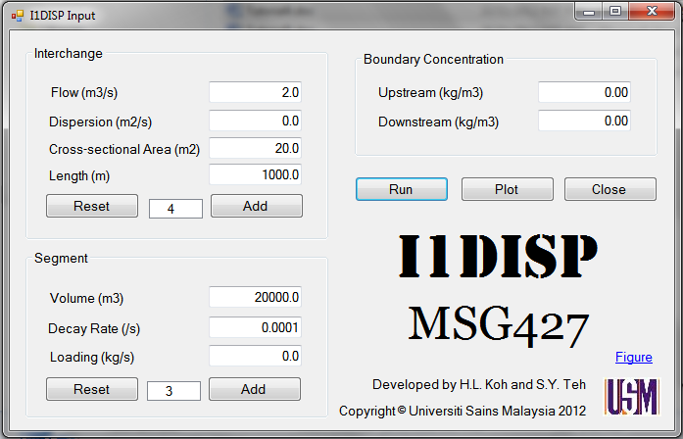
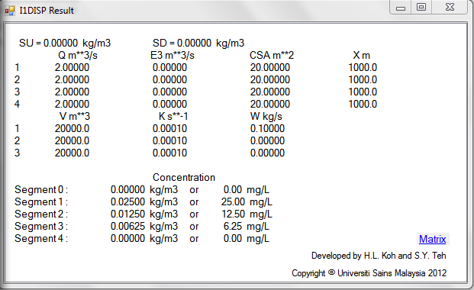
Example 3.1 – I1DISP Solution

Slide 6
Example 3.2 - Summary
A = 20 m² L = 3000 m u = 0.1 m/s
E = 0.2 m²/s Δx = 1000 m W = 0.1 kg/s
k = 10⁻⁴ s⁻¹

Slide 7
Example 3.2 – Analytical Solution

Slide 8
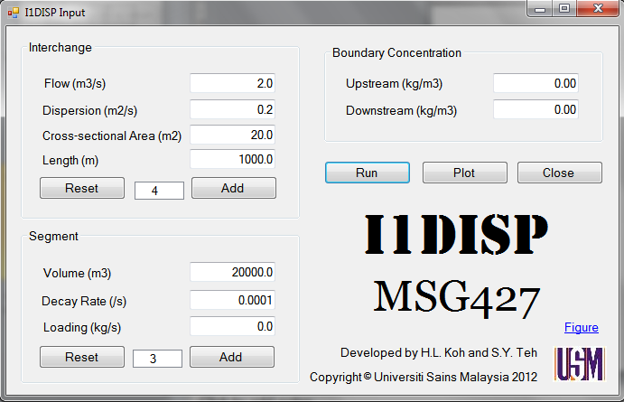
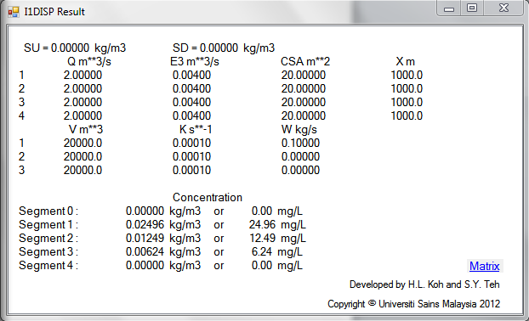
Example 3.2 – I1DISP Solution

Slide 9
Examples 3.1 & 3.2: Comparison
c (mg/L) | x (m)
 | 0 | 1000 | 2000 | 3000 | 4000
Example 3.1 | 0 | 25 | 12.5 | 6.25 | 0
Example 3.2 | 0 | 24.96 | 12.49 | 6.24 | 0

Slide 10
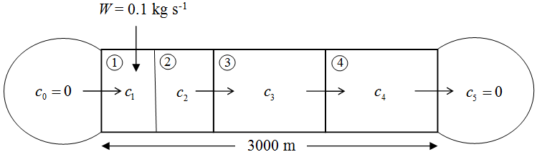
Example 3.3 - Summary
A = 20 m² L = 3000 m u = 0.1 m/s
E = 0.0 m²/s Δx = 1000 m W = 0.1 kg/s
k = 10⁻⁴ s⁻¹

Slide 11
Example 3.3 – Analytical Solution

Slide 12
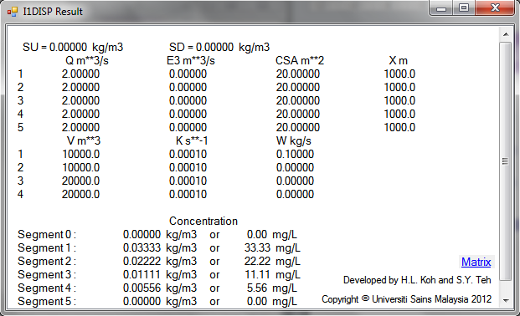

Example 3.3 – I1DISP Solution
?

Slide 13
Lake Examples

Slide 14
Example 1
A lake has the following characteristics:
Volume = 50,000 m³
Mean depth = 2 m
Inflow = outflow = 7500 m³ d⁻¹
The lake receives the input of a pollutant from three sources: a factory discharge of 50 kg d⁻¹, a flux from atmosphere of 0.6 g m⁻² d⁻¹, and the inflow stream that has a concentration of 10 mg L⁻¹. If the pollutant decays at the rate of 0.25 d⁻¹, determine the steady-state concentration.

Slide 15
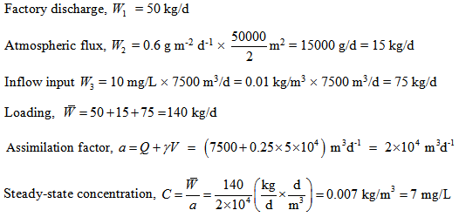
Example 1 – Analytical Solution

Slide 16
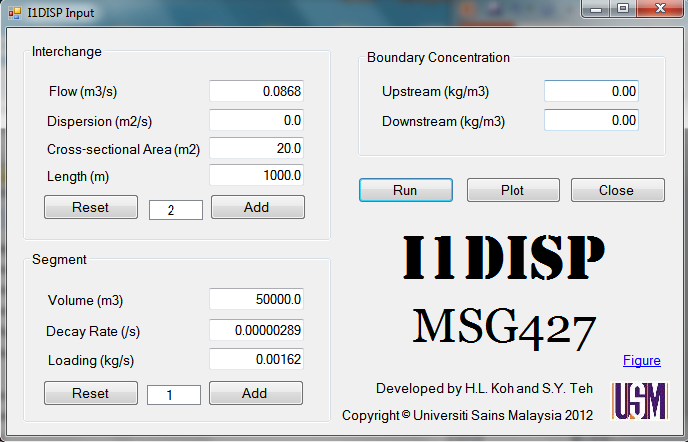
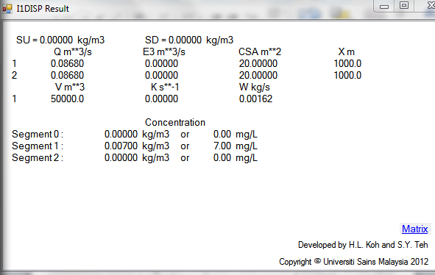
Example 1 – I1DISP Solution

Slide 17
Example 2
A pond with a single inflow stream has the following characteristics:
Mean depth = 3 m ; Surface area = 2 × 10⁵ m² ; Residence time = 2 weeks ; Inflow BOD = 4 mg L⁻¹
A subdivision housing 1000 people will discharge raw sewage into this system. Each individual contributes about 150 gal capita⁻¹ d⁻¹ of wastewater and 0.25 lb capita⁻¹ d⁻¹ of BOD. If the BOD decays at a rate of 0.1 d⁻¹ and settles at a rate of 0.1 m d⁻¹, Determine the steady-state concentration for the lake with and without the subdivision.

Slide 18
Example 2
Determine the steady-state concentration for the lake with and without the subdivision.

Slide 19
Example 2 – Without Subdivision
Inflow BOD = 4 mg L⁻¹ ⇒ C_{in} = 0.004 kg/m³

Slide 20
Example 2 – Without Subdivision

Slide 21
Example 2 – With Subdivision

Slide 22
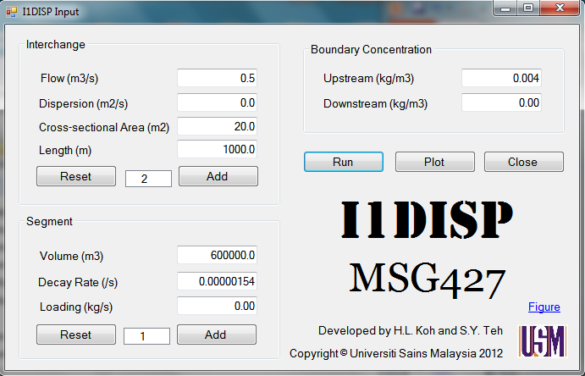
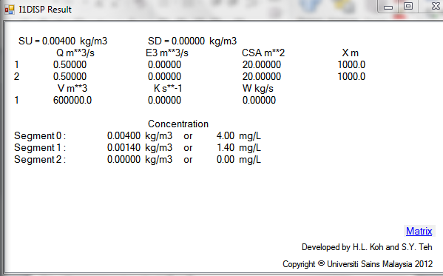
Example 2 – I1DISP Without Sub

Slide 23
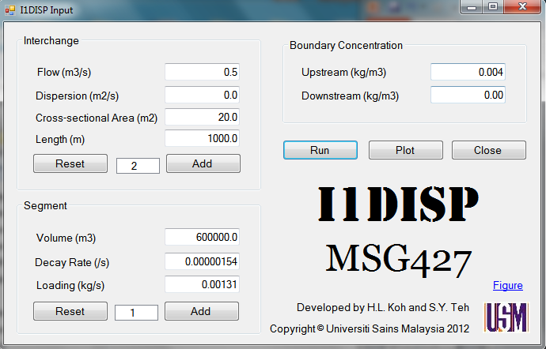
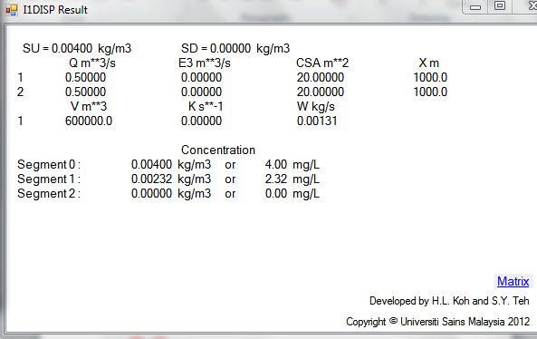
Example 2 – I1DISP With Sub

Slide 24
Thank you
Presented by
Assoc. Prof. Dr. Teh Su Yean | School of Mathematical Sciences

